Slide 1
Working with Form and Query String Data

Slide 2
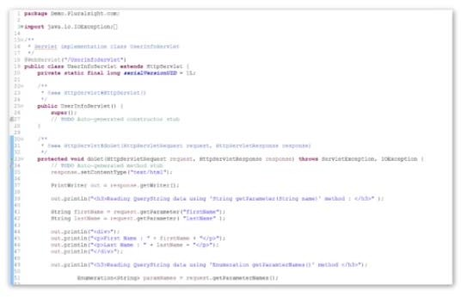
Overview
Handle HTTP-GET Request

Slide 3
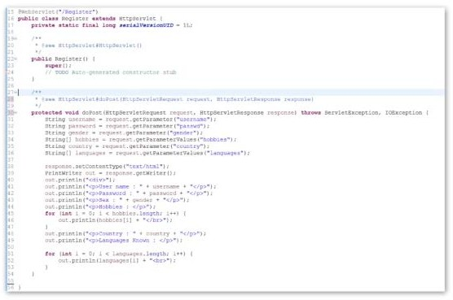
Overview
Handle HTTP-GET Request
Handle HTTP-POST Request

Slide 4
Overview
Handle HTTP-GET Request
Handle HTTP-POST Request Handle QueryString Data

Slide 5
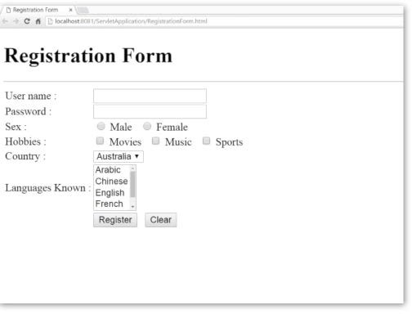
Overview
Handle HTTP-GET Request
Handle HTTP-POST Request Handle QueryString Data Creating an HTML Page

Slide 6
Overview
Handle HTTP-GET Request
Handle HTTP-POST Request Handle QueryString Data Creating an HTML Page
Access HTML Page Form data from Servlet

Slide 7
Why HttpServlet?
GenericServlet
GenericServlet is Protocol
Independent
Service method handles all
Requests
Can handle only Simple Requests Can't track Session data
HTTPServlet
Specially designed for HTTP-Protocol
Supports all HTTP-Verbs
-HTTP-GET,HTTP-POST, HTTP-PUT,HTTP-DELETE

Slide 8
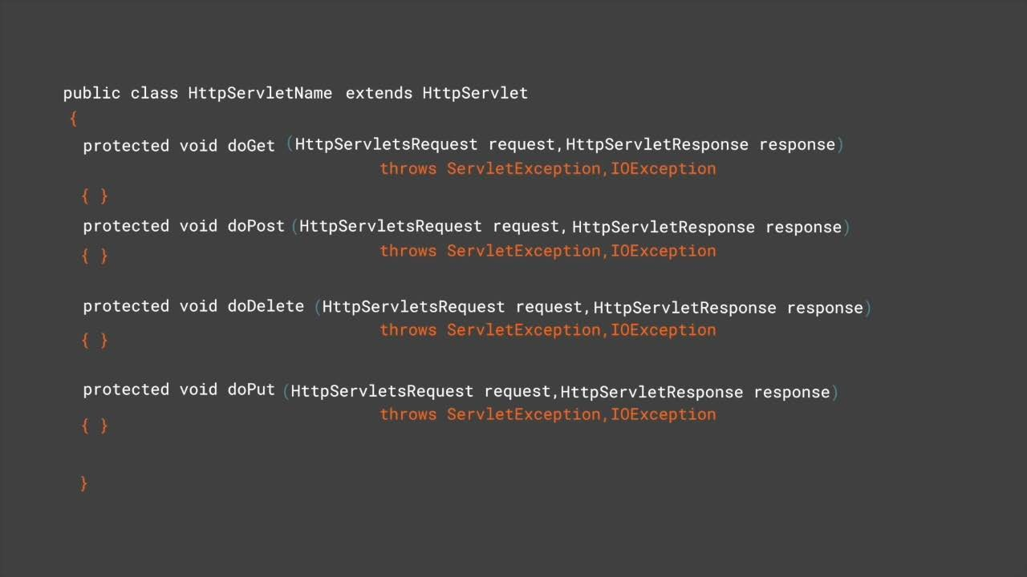

Slide 9
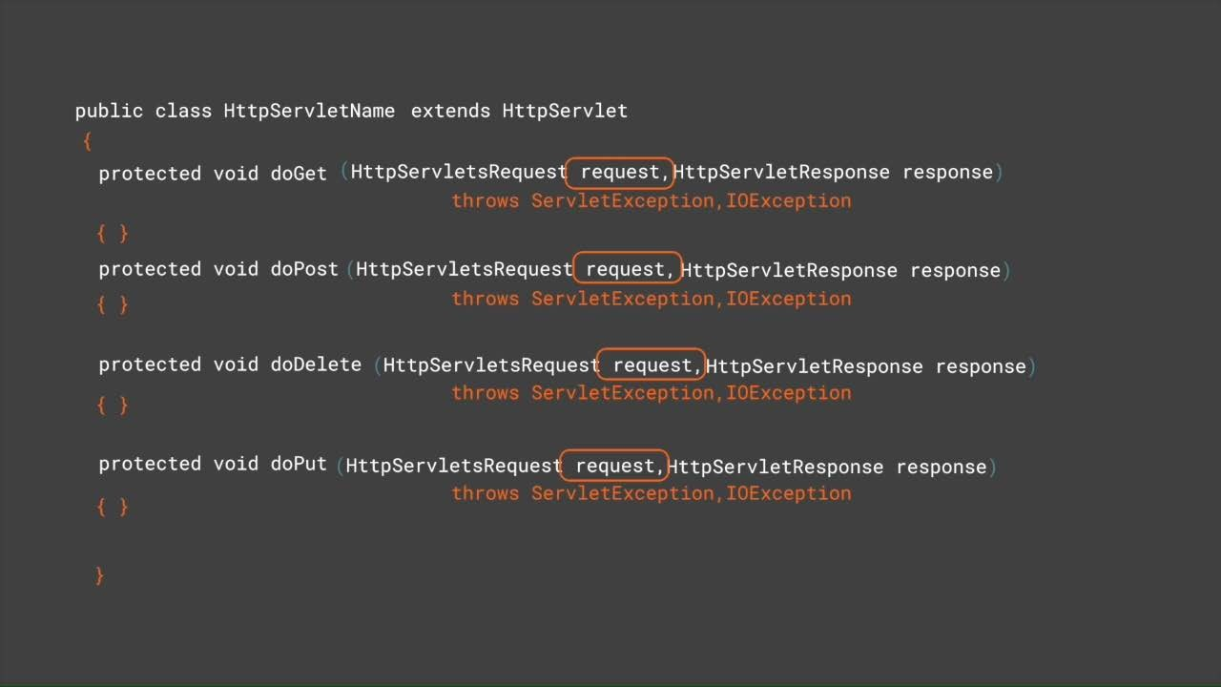

Slide 10
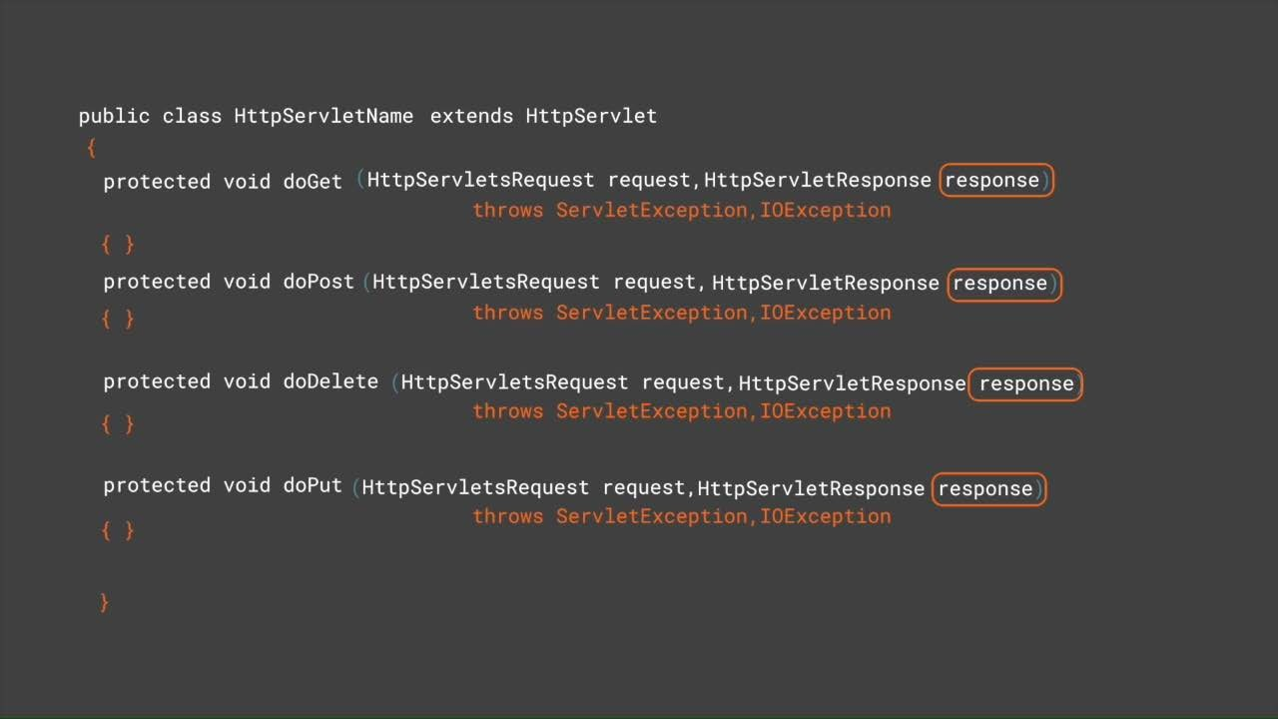

Slide 11
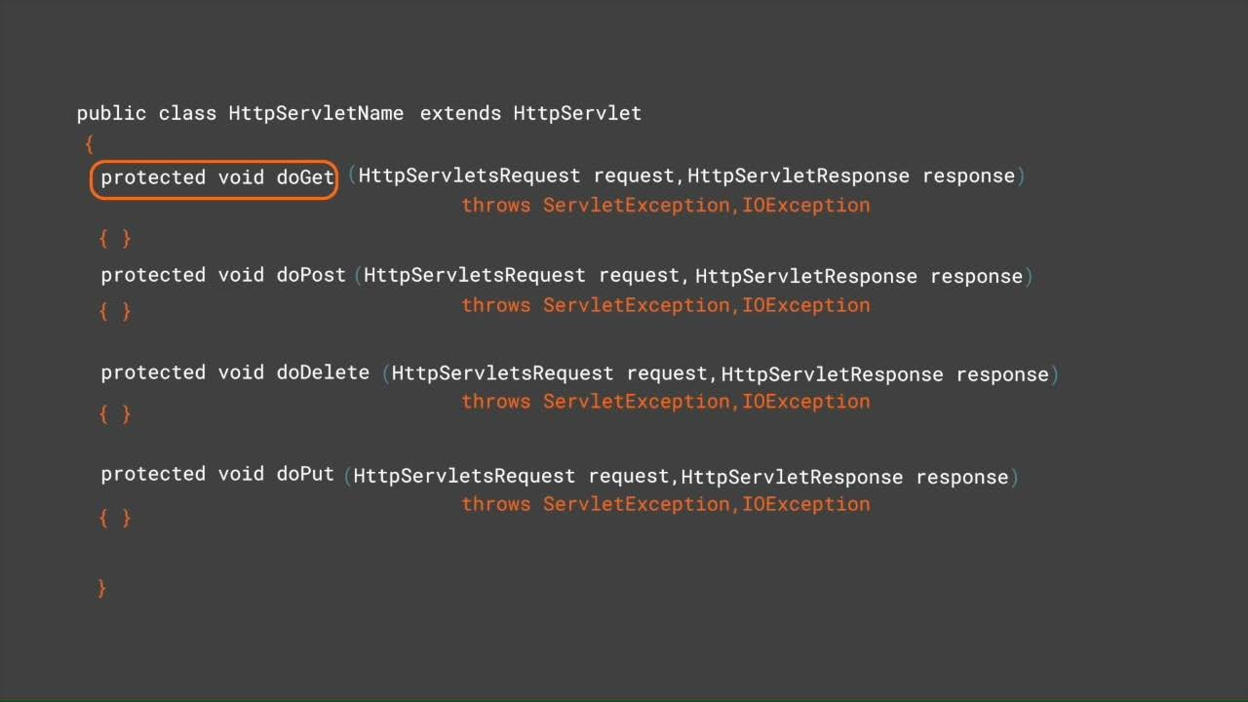

Slide 12
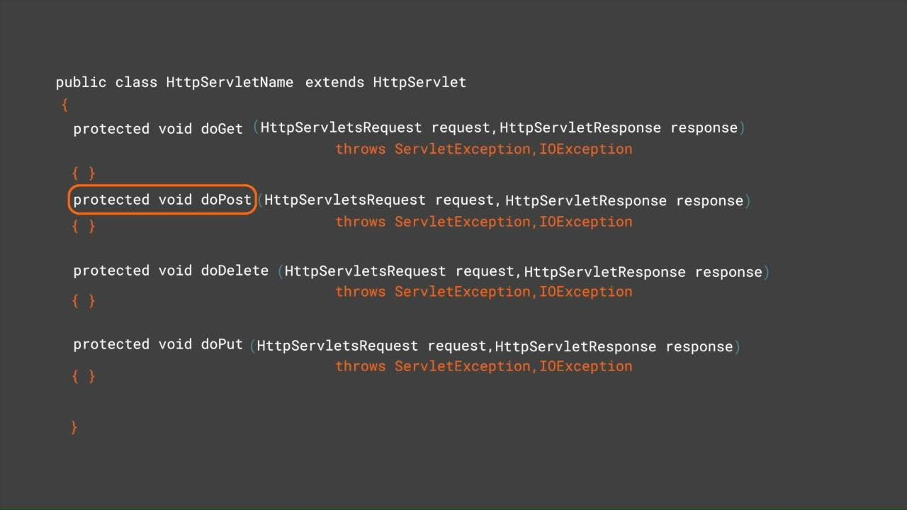

Slide 13
HTTPServletRequest Variable Methods
getParameter (String name)
getParameterValues (String name)
For Accessing Form Data
getParameterMap()
getParameterNames()

Slide 14

Assisted Practice
Handling GET Method in Servlets

Slide 15
Handling Form Data Method in Servlets
Assisted Practice

Slide 16
Handling POST Method in Servlets

Slide 17
POST
GET
Back Button / Reload Page is Harmless
Requests can be bookmarked
Requests can be Cached
Parameter values will be maintained at the Browser’s History
Size of data is limited supports 2048 characters
Supports only ASCII Characters
Less Secured
Data will be re-submitted and an alert is displayed
Requests can’t be book marked
Cache is not supported
Parameters are not saved in Browser’s History
No Size restrictions
No Restrictions on type of data submitted
Secured

Slide 18

Handling GET Method in Servlets
Handling POST Method in Servlets Handling Form Data Method in Servlets

